Slide 1
CASE STUDY OF AIR POLLUTION IN DELHI
PRESENTED BY:
NITIWIT KULDILOKE
2K19/CO/263
ZISHNENDU SARKER 2K19/CO/450

Slide 2
CONTENTS
01
INTRODUCTION
The reason of picking up and main ideas of the project
02
THEORY
Any theory included inside the project and explanation of any specifical word.
03
METHODOLOGY
The method of working in this project and how can we work
04
CASE STUDY AND ANALYSIS
We picked some case to study based on the topic we picked up
05
Conclusion
The benefit of this case study and what we have leant from this case which we worked on

Slide 3
INTRODUCTION

Slide 4
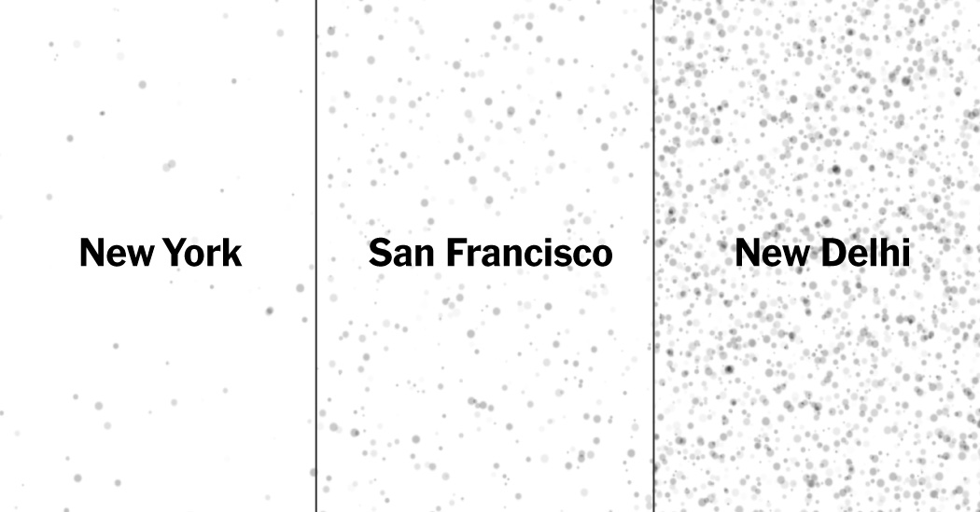
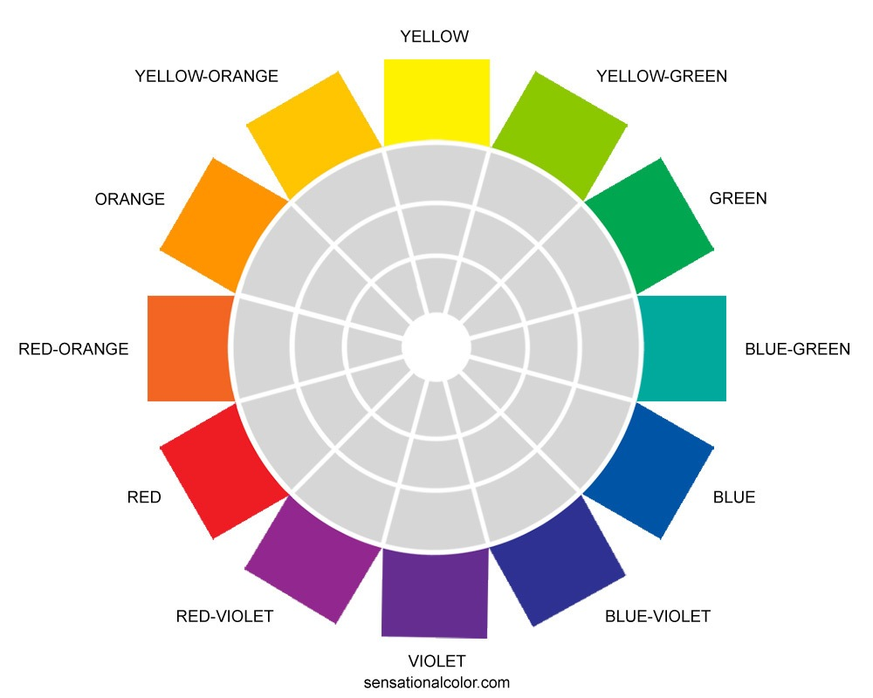
Air pollution is the introduction of particulates, biological molecules, or other harmful materials into Earth’s atmosphere, causing diseases, death to humans, damage to other living organisms such as animals and food crops, or the natural or built environment.
Air pollution can result from both human and natural actions. Natural events that pollute the air include forest fires, volcanic eruptions , wind erosion , pollen dispersal, evaporation of organic compounds and natural radioactivity. Pollution from natural occurrences are very not often
WHAT IS AIR POLLUTION?

Slide 5
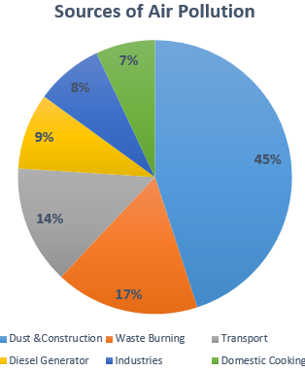
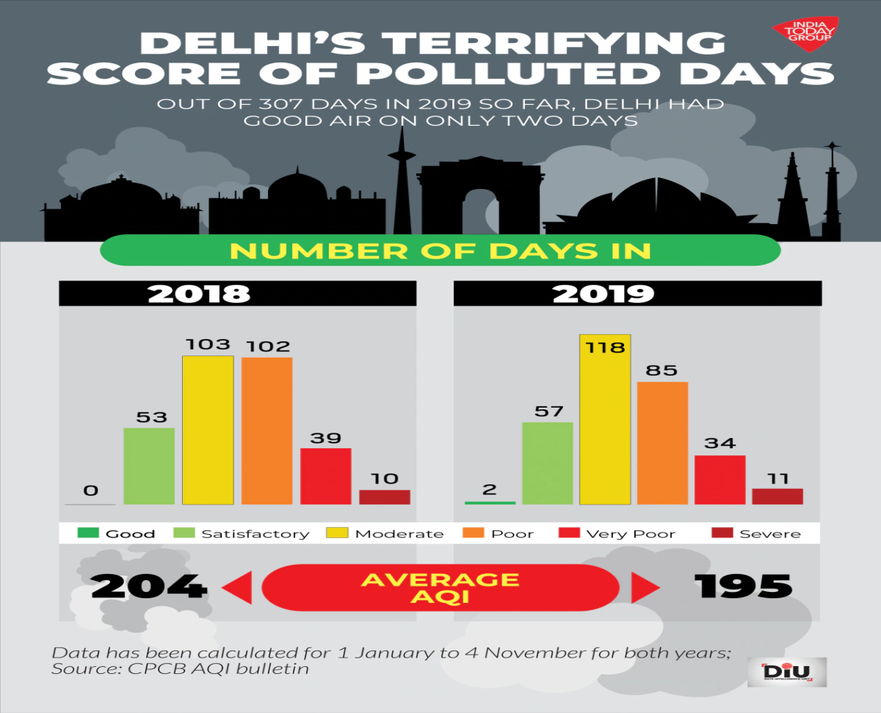
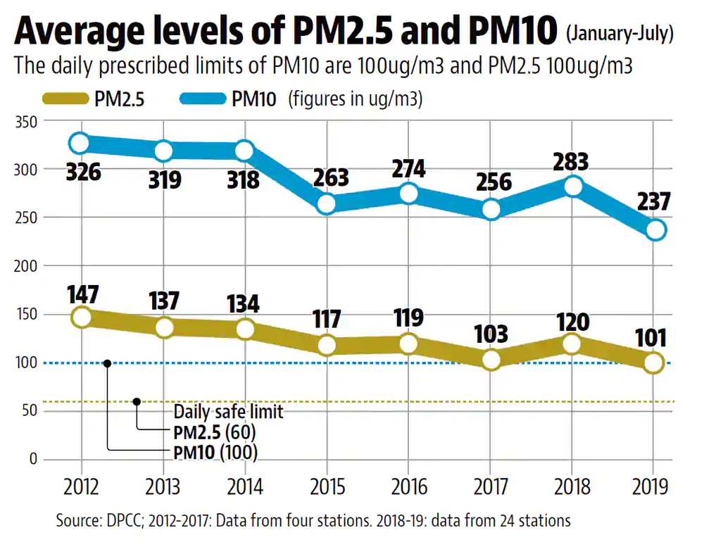
ALL HAPPENING IN DELHI
AWESOME
PRESENTATION
PRESENTATION
Power PowerPoint Presentation
2008 ~ 2015 Text here
Example Text : Get a modern PowerPoint Presentation that is beautifully designed.
2016 ~ 2020 Text here
Example Text : Get a modern PowerPoint Presentation that is beautifully designed

Slide 6
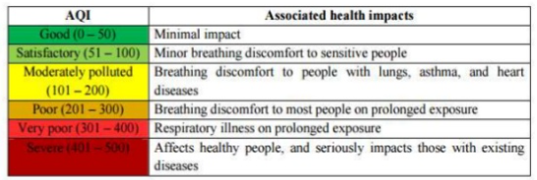
AIR QUALITY INDEX(AQI)
Air quality index (AQI) is the tool to monitor air quality in major urban cities across the country on a real - time basis and to enhance public awareness. The AQI developed Is based on human exposure and health effects and may not be strictly applicable to ecologically sensitive areas. Various pollutants which are considered for AQJ determination are PM10, PM2.5, N02, 03, CO,502, NH3, and Pb

Slide 7
POLLUTANTS:-
Primary pollutants
Secondary pollutants
Produced from a direct process, such as ash from a volcanic eruption. • Examples : Carbon monoxide gas from motor vehicle exhaust Sulphur dioxide released from factories
Not emitted directly, rather form in the air when primary pollutants react or interact. • Example : Ground level ozone

Slide 8
EFFECT ON HEALTH:-
Short-term effects – • Irritation to the eyes, nose and throat • Respiratory infections such as bronchitis • Pneumonia • Headaches • Nausea • Allergic reactions. • Short-term air pollution can aggravate the medical conditions of individuals with asthma and emphysema.

Slide 9
Long-term Effects -
• Chronic respiratory diseases • Lung cancer • Heart disease • Damage to the brain, nerves, liver, or kidneys. • Continual exposure to air pollution affects the lungs of growing children and may aggravate or complicate medical conditions in the elderly.

Slide 10
PM 2.5 LEVEL IN 2019

Slide 11
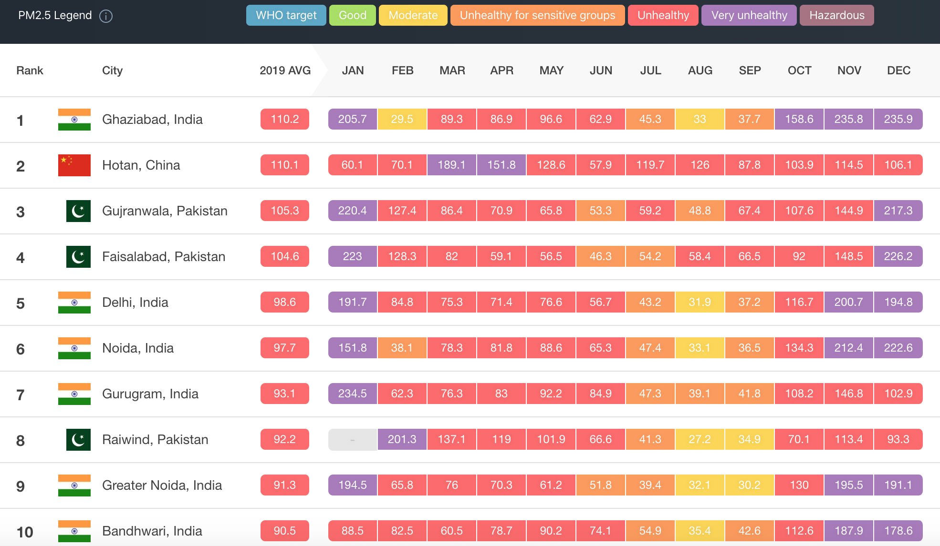

Slide 12
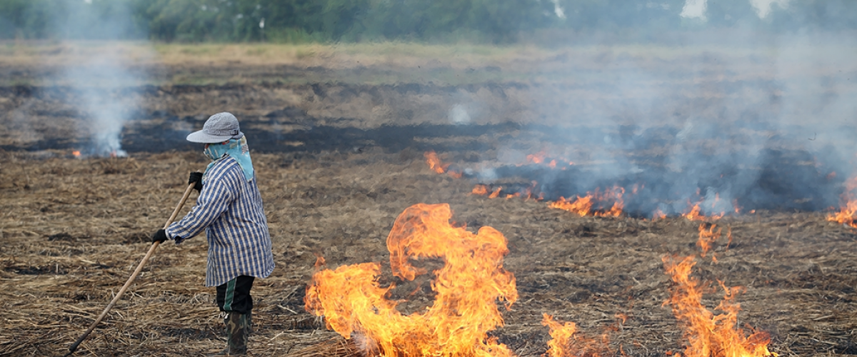
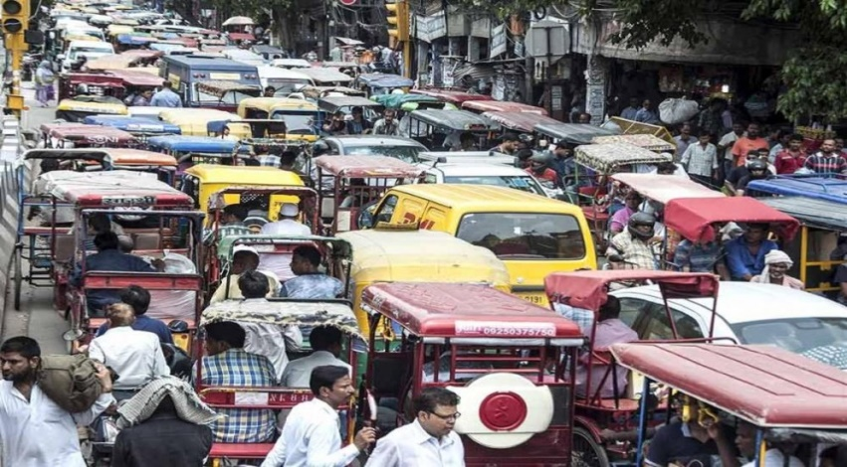
CAUSES OF AIR POLLUTION IN DELHI
National capital shares its border with the states of Haryana and Uttar Pradesh. One of the main reasons of increasing air pollution levels in Delhi is crop burning by the farmers in these states. Farmers burn rice stubbles in Punjab, Haryana and Uttar Pradesh. It is estimated that approximately 35 million tones of crop are set afire by these states. The wind carries all the pollutants and dust particles, which have got locked in the air.
2. Pollution caused by the traffic menace in Delhi is another reason contributing to this air pollution and smog. The air quality index has reached ‘severe’ levels. Vehicular emission is increasing the hazardous effects of air pollution and smog. The Central Pollution Control Board (CPCB) and the National Environmental Engineering Research Institute (NEERI) have declared vehicular emission as a major contributor to Delhi’s increasing air pollution.

Slide 13
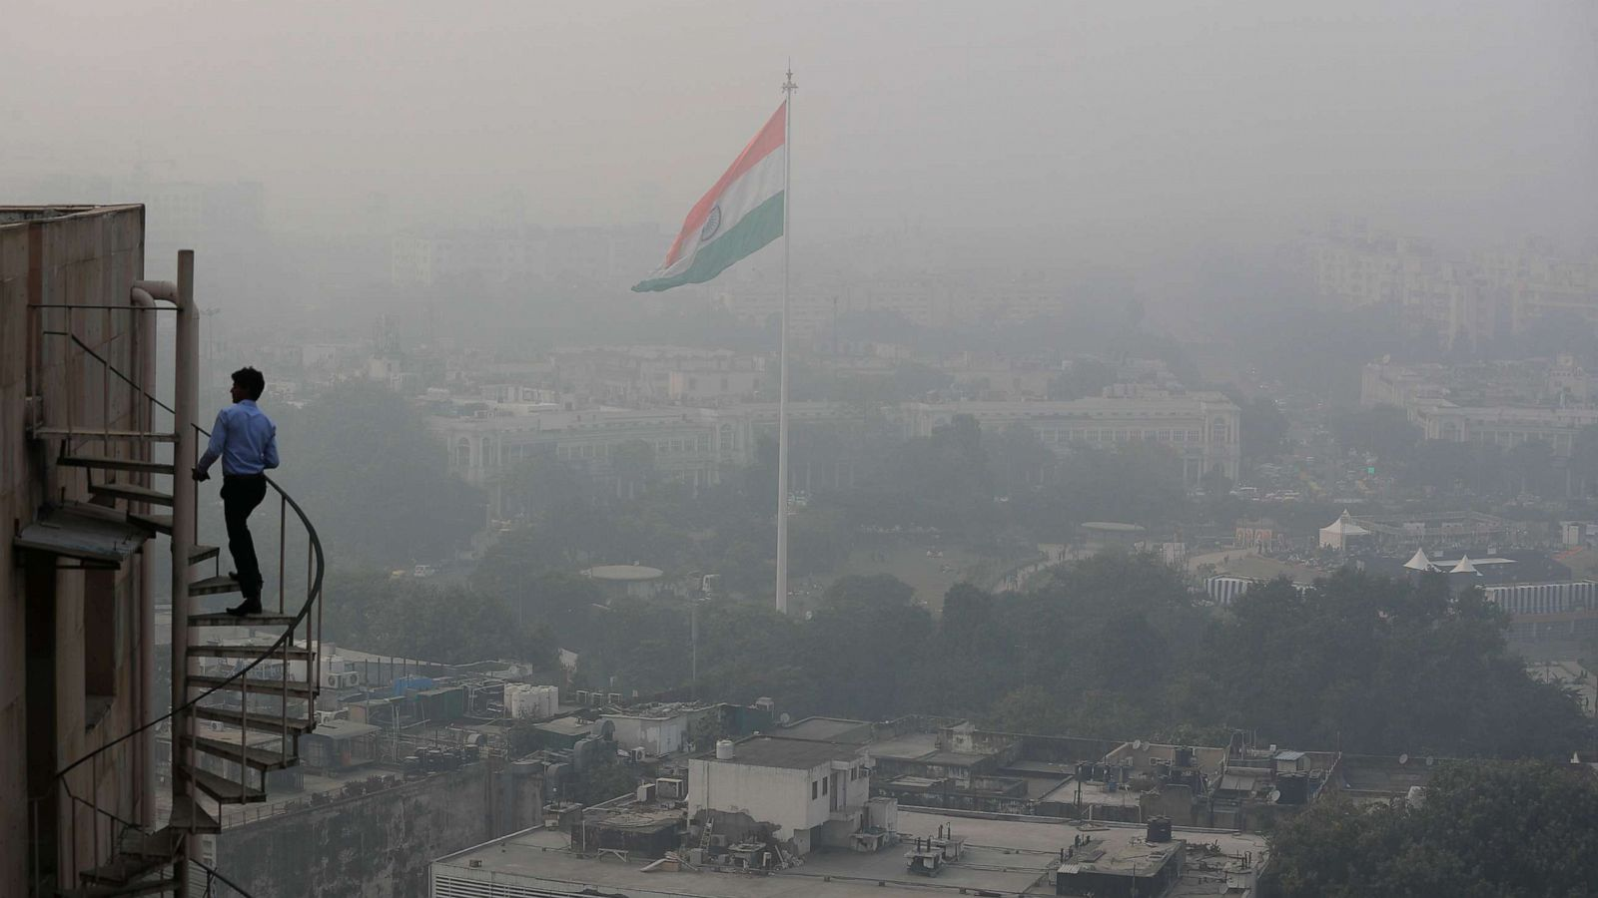
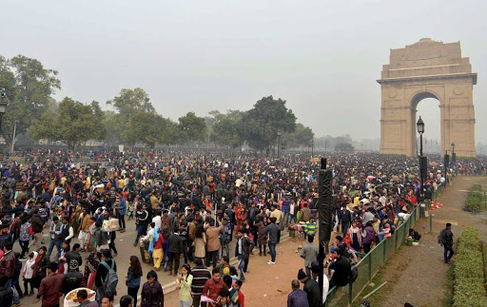
3. As the winter season sets in, dust particles and pollutants in the air become unable to move. Due to stagnant winds, these pollutants get locked in the air and affect weather conditions, resulting in smog.
4. Another reason of air-pollution is over-population in the capital. Over-population only adds up to the various types of pollution, whether it is air pollution or noise pollution.

Slide 14
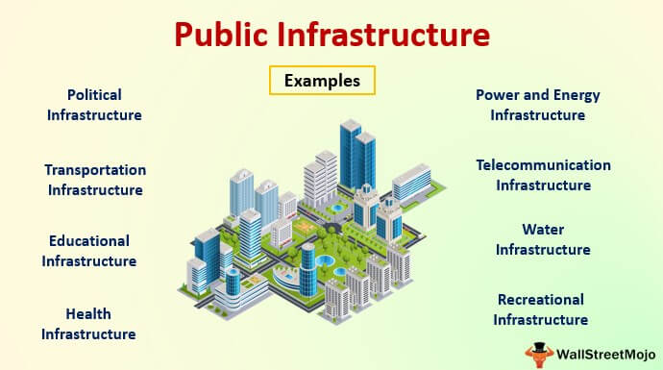
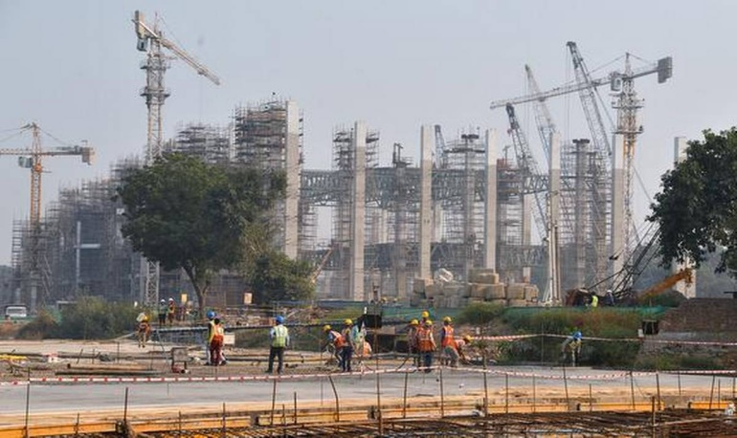
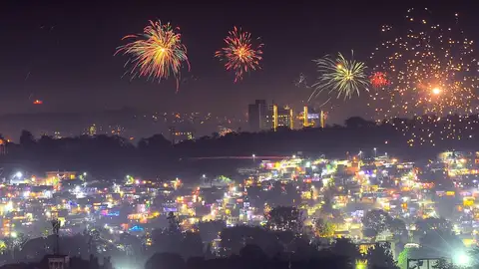
5. Investing less on public infrastructure is another reason of air pollution. In India, investment in public transport and infrastructure is low which leads to congested roads, and hence air pollution.
6. Large scale construction in Delhi-NCR is another culprit that is increasing dust and pollution in the air. Considering the dipping air quality, a number of construction sites have stalled work, as directed by the Delhi Government.
7. Despite the ban on cracker sales, firecrackers were a common sight this Diwali. It may not be the top reason for this smog, but it definitely contributed to its build up.

Slide 15
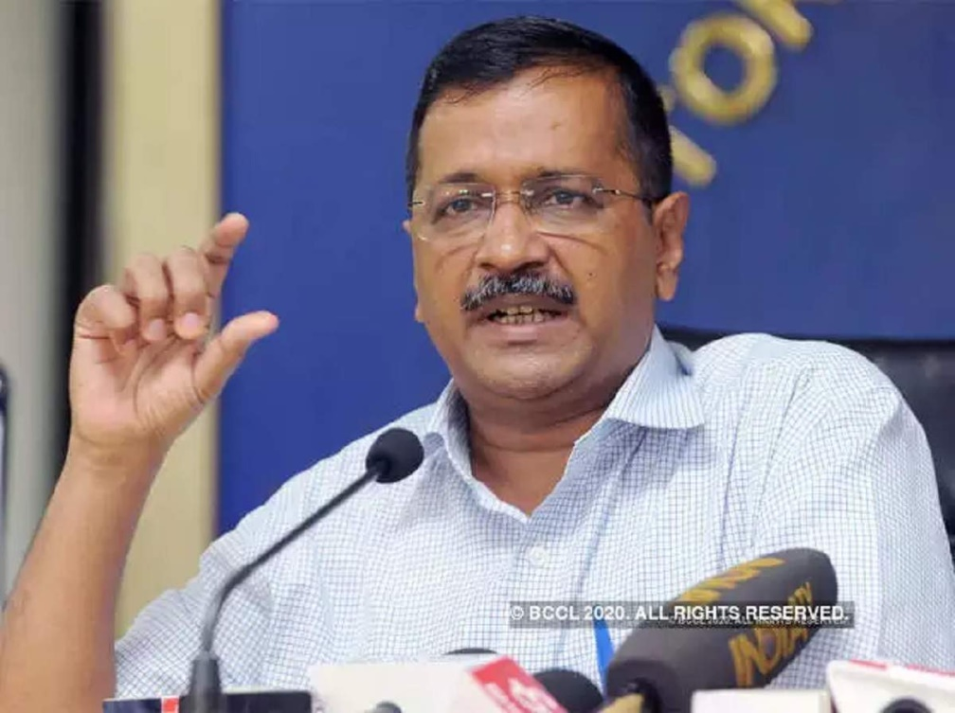

Arvind Kejriwal said:
“Delhi pollution is down by 25%. Delhi is the only city where pollution is going down instead of increasing.”
.
Reality check says... The level of one of the most harmful pollutants has come down in recent years. But it’s still relatively high and there are concerns about increases in other pollutants in Delhi’s air

Slide 16
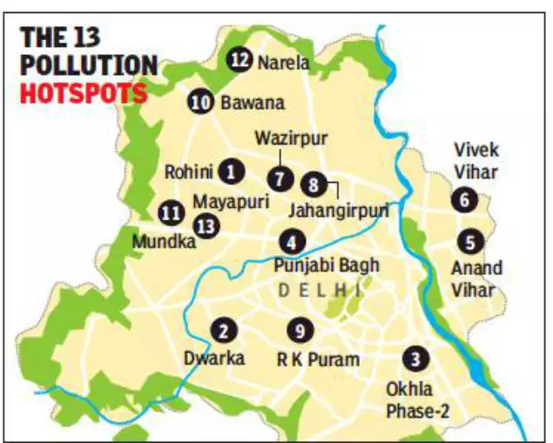
STEPS TAKEN BY THE GOVERNMENT TO REDUCE AIR POLLUTION
Identifying pollution hotspots
The Delhi government has identified 13 hotspots — where the level of pollution is higher than other areas — in order to identify the source of pollution. These hotspots include industrial areas, as well as those where waste burning, road dust and traffic congestion are a particularly frequent. They are Okhla Phase-II, Dwarka, Ashok Vihar, Bawana, Narela, Mundka, Punjabi Bagh, Wazirpur, Rohini, Vivek Vihar, Anand Vihar, R.K. Puram and Jahangirpuri.

Slide 17
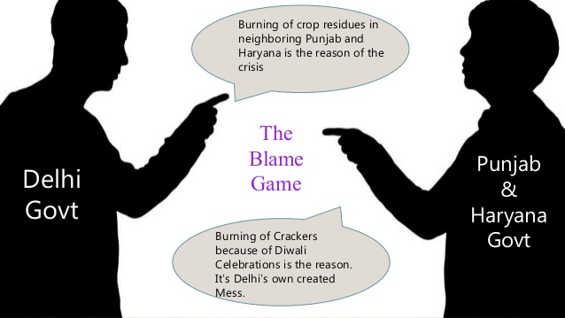
Coordination with other states
Farmers in Haryana and Punjab clear out their land for winter sowing by burning the stubble left over from the monsoon paddy harvest. The plumes of smoke rising from the ensuing fires are believed to be among the primary drivers of smog in Delhi.
This year, Delhi will be spraying crop residue with a solution developed by the Indian Agricultural Research Institute that can reportedly decompose and convert it into manure. “If the technique is found to be useful, we can ask other states to implement it to prevent stubble burning,” the CM said Monday.

Slide 18

Green Delhi app
CM Kejriwal announced Monday that a mobile app called Green Delhi will be launched in the coming days to encourage public participation in the battle against pollution. Anyone in Delhi who witnesses a source of pollution — vehicular, industrial or otherwise — can click a photograph and post it on the app. The Green War Room, as mentioned before, will track the status of complaints registered under the app, with Kejriwal promising personal oversight.

Slide 19
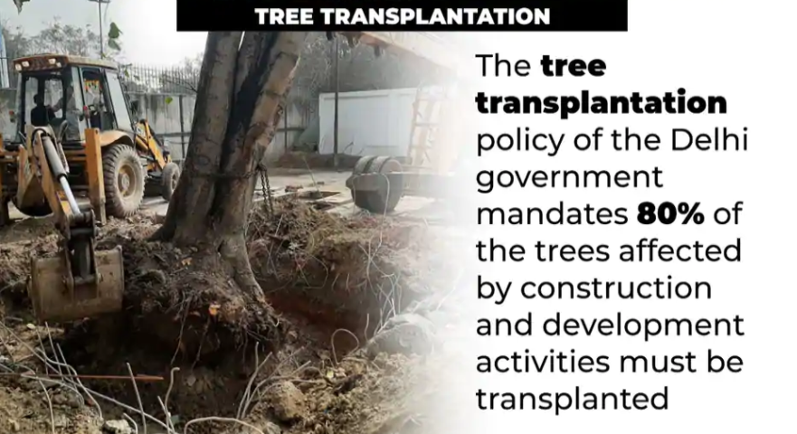
The tree transplantation policy of the Delhi government mandates 80% of the trees affected by construction and development activities must be transplanted, along with 80% out of them surviving after a year. This is in addition to the mandatory requirement of planting 10 saplings in case one tree is cut for construction purposes, which has helped increase the green cover in Delhi.

Slide 20
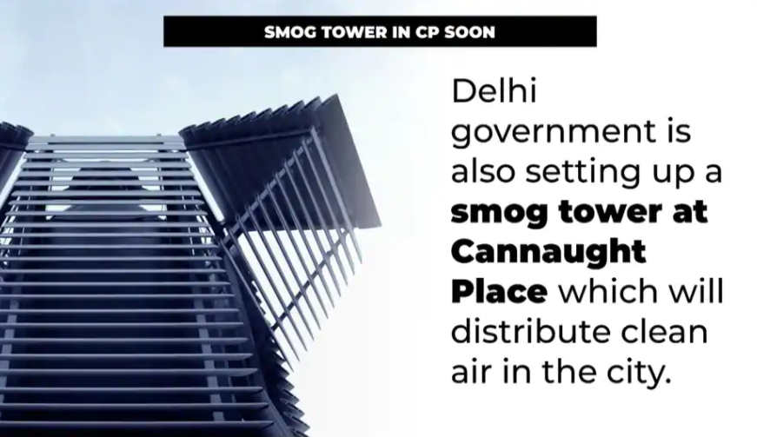
ssSMOG TOWER IN CP
DELHI GOVERNMENT has established a SMOG TOWER AT CANNAUGHT PLACE which will distribute clean air in the city
To reduce pollution in the city, the Delhi government is also setted up a smog tower at Connaught Place which will distribute clean air in the national capital.

Slide 21
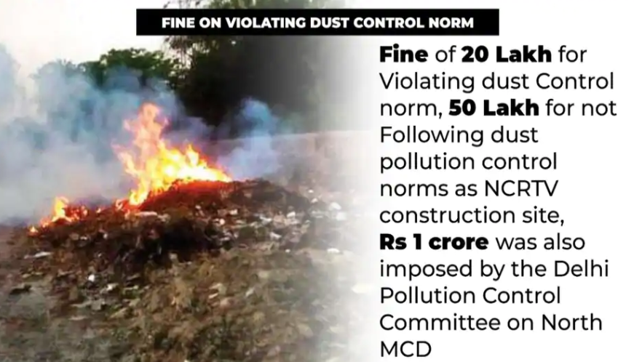
Recently, a fine of Rs 1 crore was also imposed by the Delhi Pollution Control Committee on North MCD for its negligence regarding garbage burning in Kirari area.

Slide 22
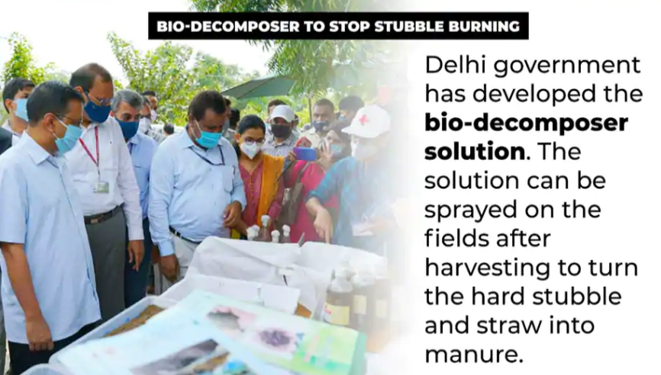
The Delhi government has developed a bio-decomposer solution under the guidance of Pusa Agricultural Institute. The liquid solution, which was primarily developed and tested by the Pusa Institute, has been accepted as a viable alternative to stubble burning by the Delhi government. The solution can be sprayed on the fields after harvesting to turn the hard stubble and straw into manure. The solution will be provided to the farmers of Delhi and sprayed on their farmlands by the Delhi government, without the farmers having to bear the cost of the same.

Slide 23
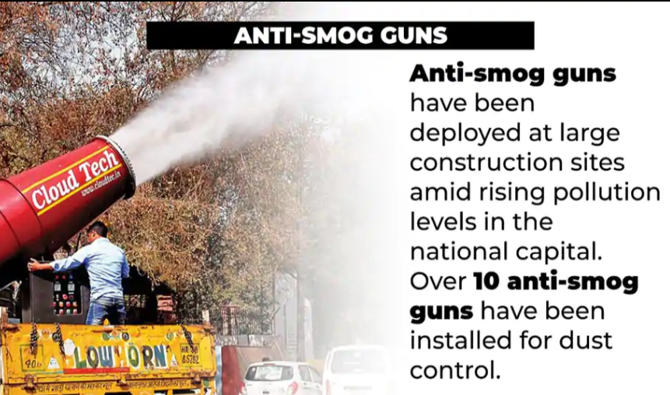
Anti-smog guns have been deployed at large construction sites amid rising pollution levels in the national capital. Over 10 anti-smog guns have been installed for dust control.

Slide 24
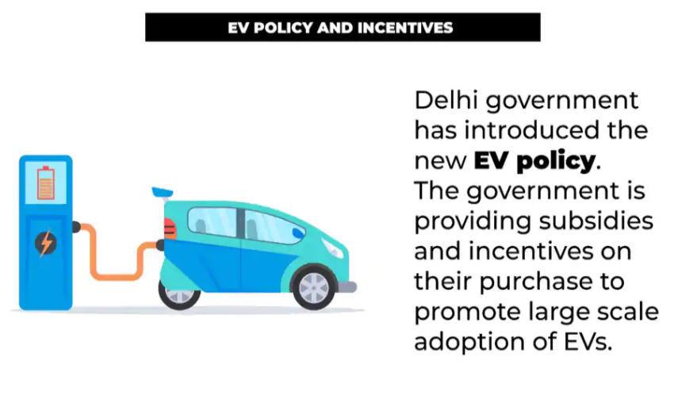
In an effort to reduce the contribution of vehicular emissions to Delhi's PM2.5 concentrations, the Delhi government has introduced the new EV policy. The government is providing subsidies and incentives on their purchase to promote large scale adoption of EVs.

Slide 25
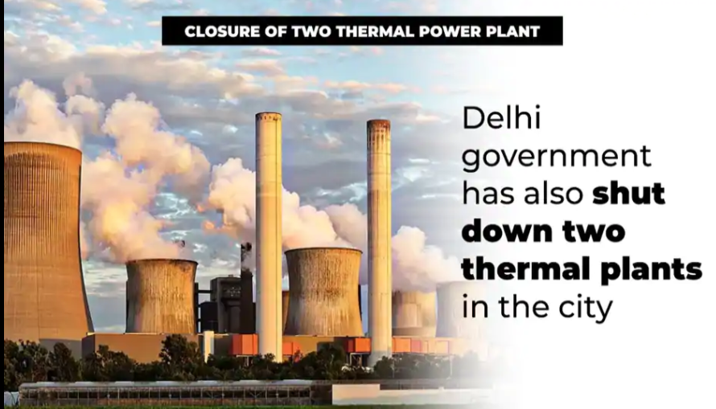
Since thermal energy is one of the most polluting sources of energy, the Delhi government has also shut down two thermal plants in the city, and has also appealed to the other states to shut down 11 thermal power plants around Delhi which continue to be one of the major causes of pollution.

Slide 26
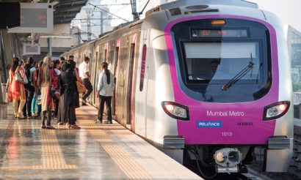
Increase bus and metro services
Mr. Kejriwal said on 18 March 2020 delivering on another pledge he has made to the Delhi’s electorate: putting over 11,000 additional buses on Delhi’s roads.
AGENCIES RESPONSIBLE:-
Principal Secretary
Department of Transport of NCT of Delhi Delhi Transport Corporation (DTC)
Delhi Integrated Multi-modal Transit System Ltd (DIMTS)
Delhi Metro Rail Corporation (DMRC) State Transport Corporations in NCR towns

Slide 27
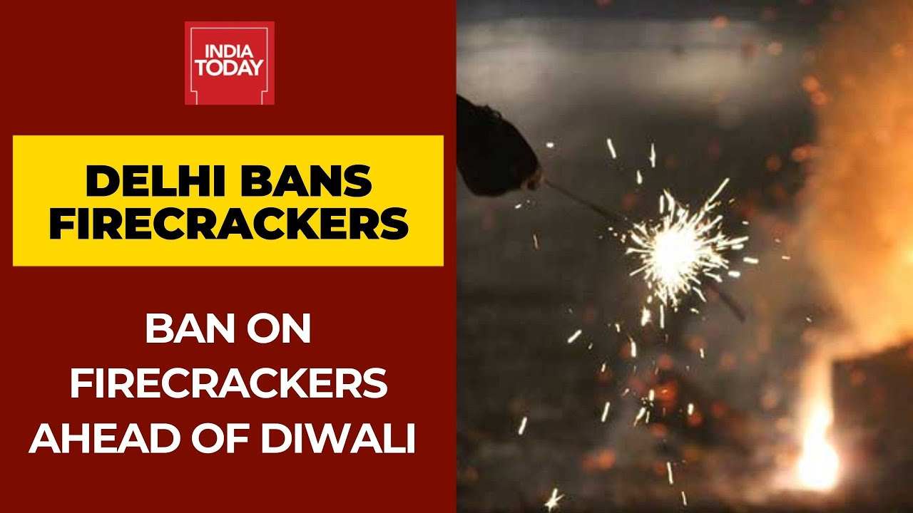
"In the wake of the rising pollution in Delhi due to the festival season, the Delhi government has decided to put a complete ban on the sale, purchase, and use of firecrackers in the city from November 7 to November 30, 2020“
Use of green crackers will not remedy the situation. The smoke will choke and may create a gas chamber like situation. It will lead to poor visibility, hazy conditions and asphyxia

Slide 28
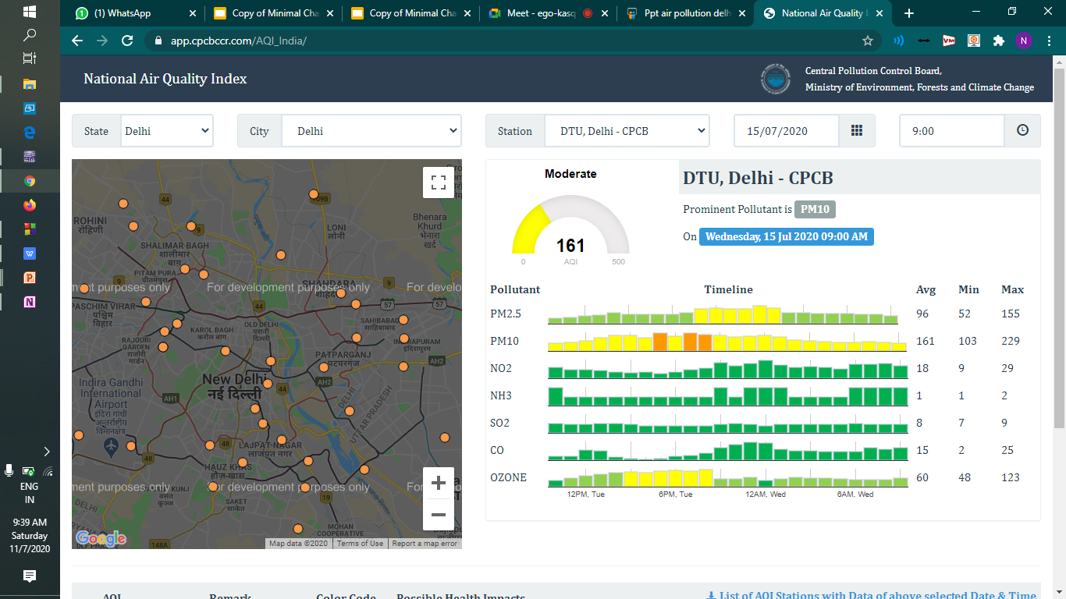
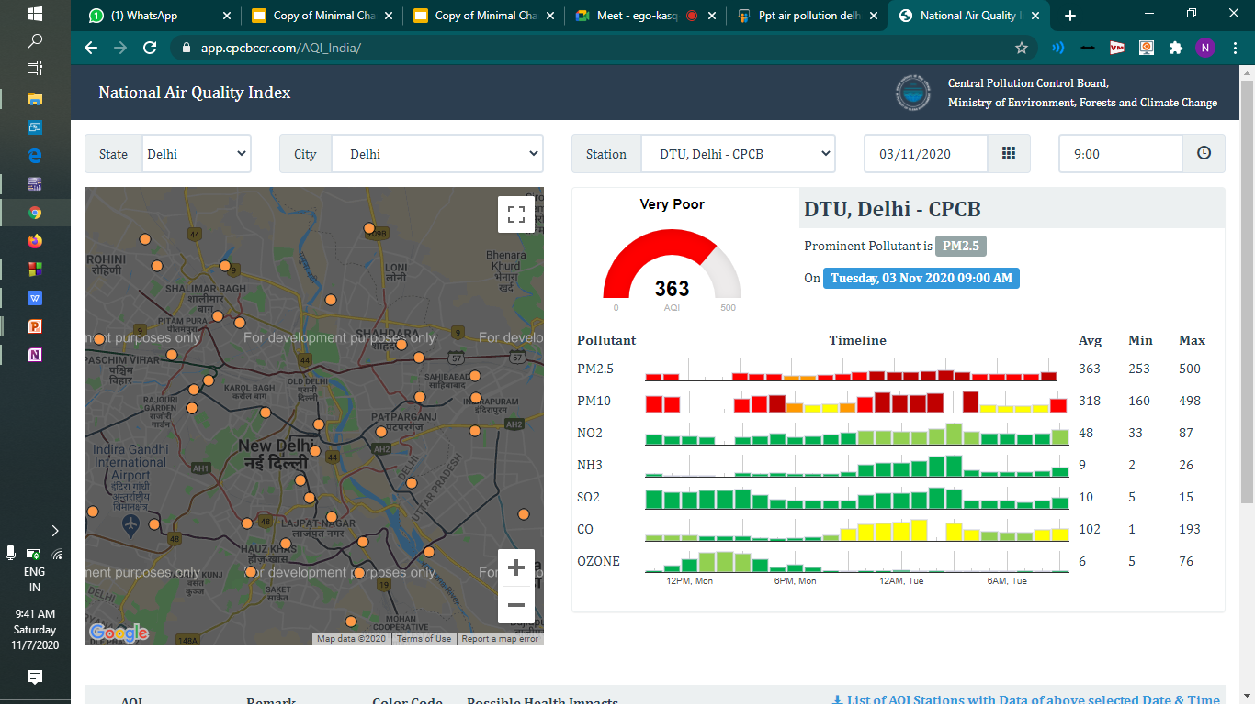
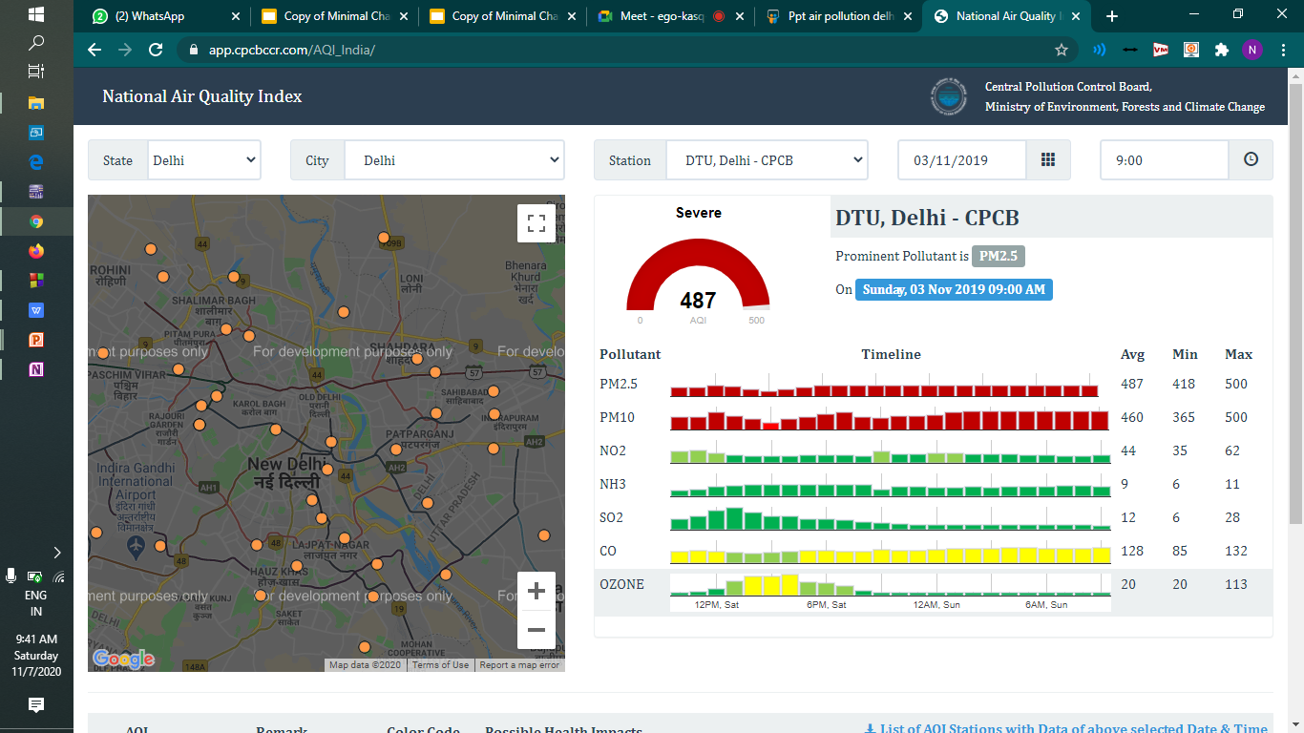

Slide 29
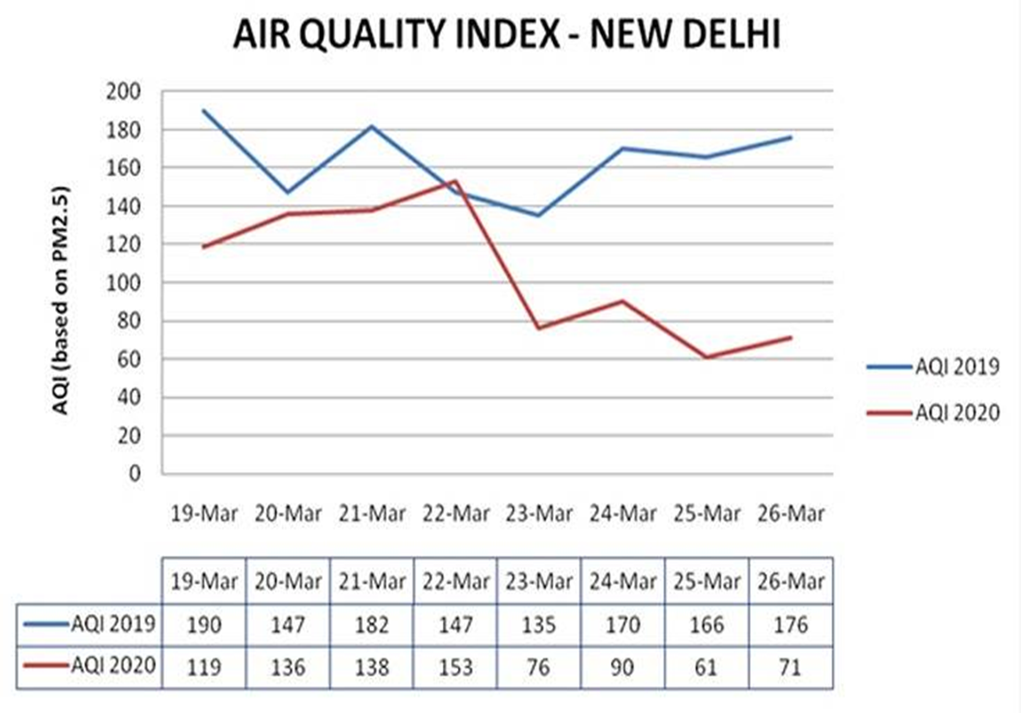

Slide 30
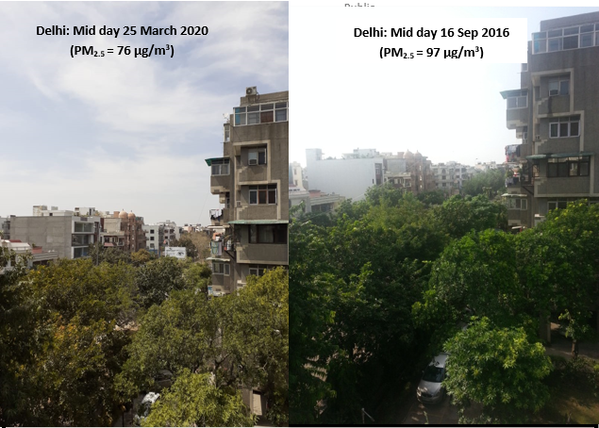
PHOTO OF
Delhi: Mid day 12 April 2021
(PM2.5= 68 ug/m3

Slide 31
CONCLUSION
The Government of National Capital Territory of Delhi has taken several steps to reduce the level of air pollution in the city during the last 10 years. The benefits of air pollution control measures are showing in the readings. However, more still needs to be done to further reduce the levels of air pollution. The already existing measures need to be strengthened and magnified to a larger scale. The governmental efforts alone are not enough. Participation of the community is crucial in order to make a palpable effect in the reduction of pollution. The use of public transport needs to be promoted. More frequent checking of Pollution Under Control Certificates needs to be undertaken by the civic authorities to ensure that vehicles are emitting gases within permissible norms. People need to be educated to switch-off their vehicles when waiting at traffic intersections. The ever-increasing influx of migrants can be reduced by developing and creating job opportunities in the peripheral and suburban areas, and thus prevent further congestion of the already-choked capital city of Delhi.

Slide 32
THANK YOU
SO
MUCH
THAT’s
OUR
PRESENTATION

